Slide 1


CDAC ACTS
Knowledge Park, Bengaluru
Presentation on
“Bus Ticket Reservation System”
E-DAC May 2021
Created By: Group No:21
Tejaswini Alone (210550181009)
Bulbul Varshney(210550181034)
MD Ali Ahmad(210550181066)
Ashish Chaudhary(210550181027)
Vikas Patel(210550181122)
Uma Prasad Mr. Kalai Selvan K
Center Coordinator Project Guide

Slide 2
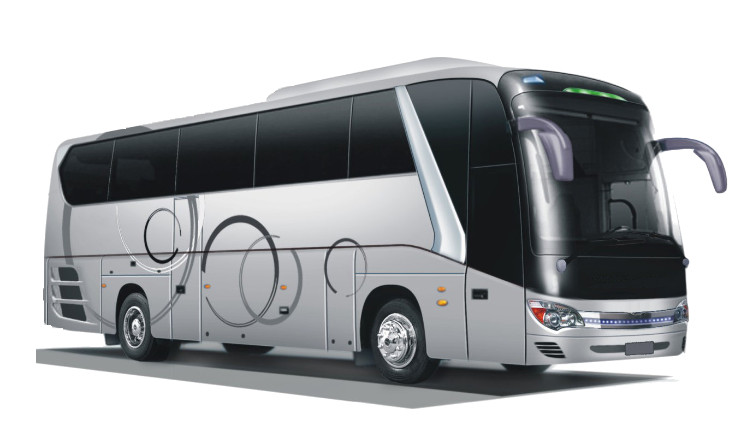
CONTENT
1
7
Use Case Diagrams
Introduction
8
2
Scope
ER Diagram
9
3
Aim and Objective
Benefits of System
4
10
Activity Diagram
Activity Diagram
5
11
Future Scope
Features
6
12
Reference
ScreenShots

Slide 3

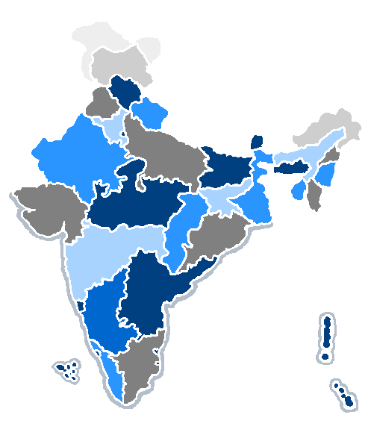
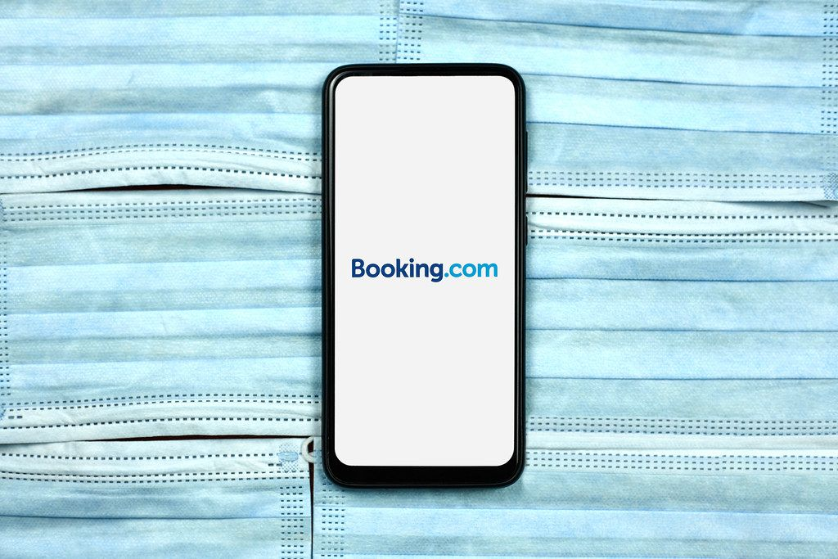
CONTENT
INTRODUCTION
7
Use Case Diagrams
Reserve tickets online
8
ER Diagram
2
Scope
BUS TICKET RESERVATION SYSTEM
9
3
Aim and Objective
Benefits of System
Book tickets from remote location
4
10
Activity Diagram
Activity Diagram
5
11
Future Scope
Travel Agency can use it for there customers
Features
6
12
Reference
ScreenShots

Slide 4




SCOPE
Travel Agency to issue the tickets to the customers.
The customer to enquire the availability of seats
A particular bus for the specific date from desired location
The facility to check the timings
Schedule of the buses along with the ticket price.

Slide 5


AIMS AND OBJECTIVES

Slide 6
AIMS AND OBJECTIVES
User friendly
Simple, corrective
Reliable
Less time consuption
Increase the ticket booking efficiency
Up to date information

Slide 7
FEATURES PROVIDED TO USER
Like Arrival Time, Destination Time
Register
Re-login
Check Seats Available
Check Already Available Seats
Sources And Destination
Arrival Time, Destination Time

Slide 8
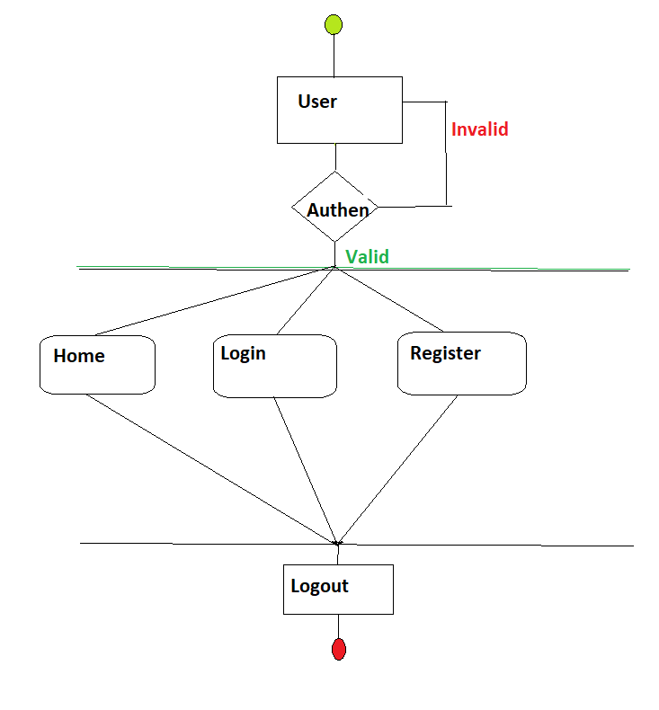

ACTIVITY DIAGRAM FOR USER

Slide 9
SCREENSHOTS FOR USER PERFORMED OPERATION

Slide 10
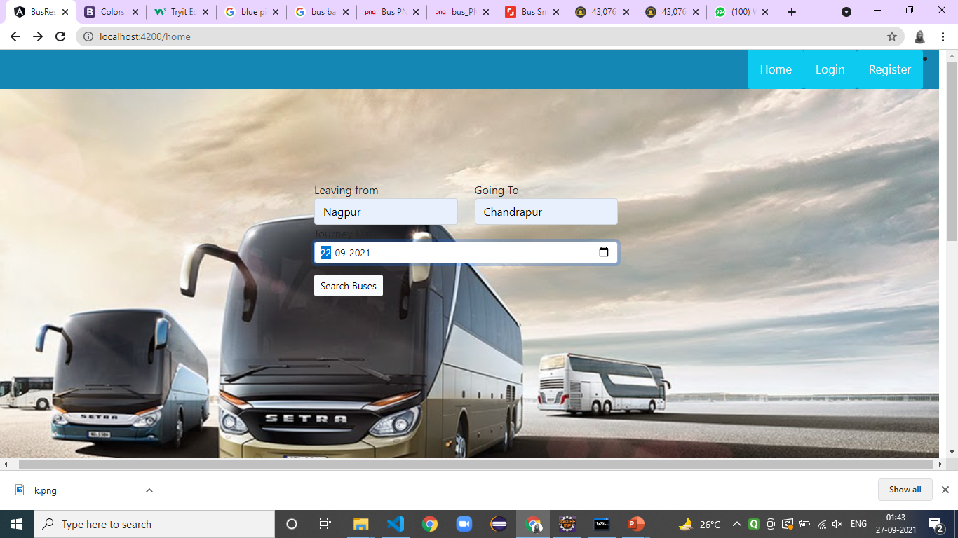

Slide 11
Now on clicking on search
you can check the
buses and there timing

Slide 12
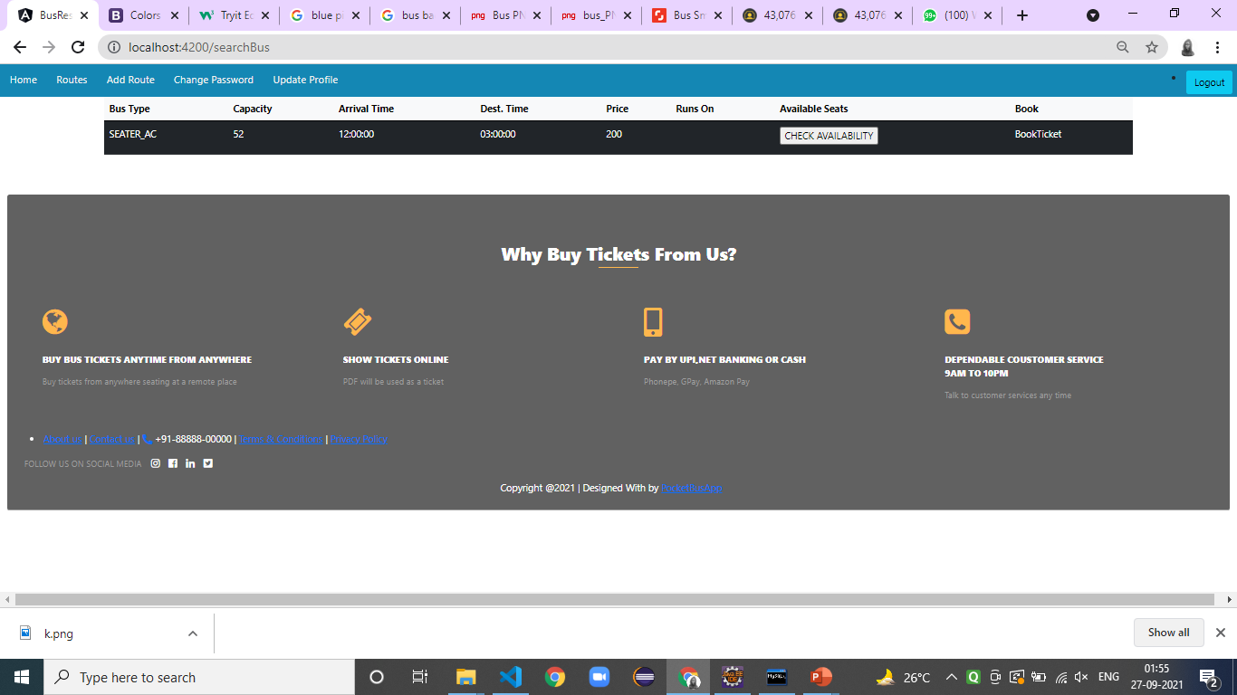

Slide 13
Here you can check which bus is available ,its capacity, time, price and then book ticket

Slide 15
Here you can check which bus is available ,its capacity, time, price and then book ticket

Slide 16
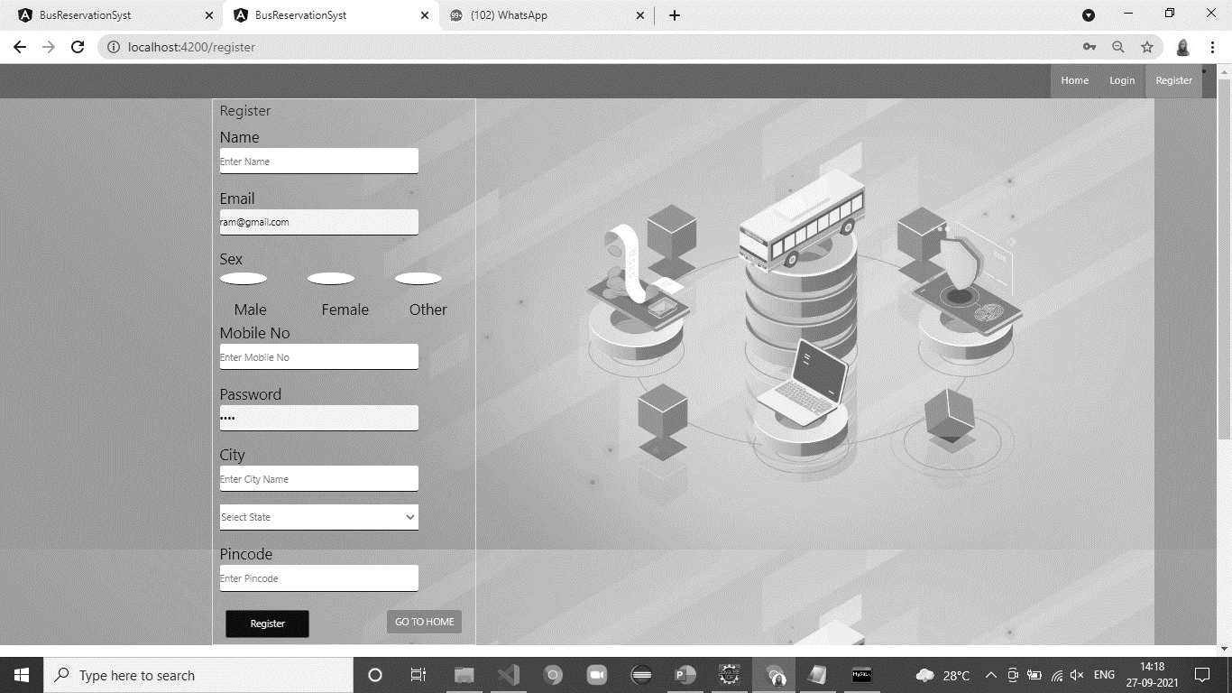
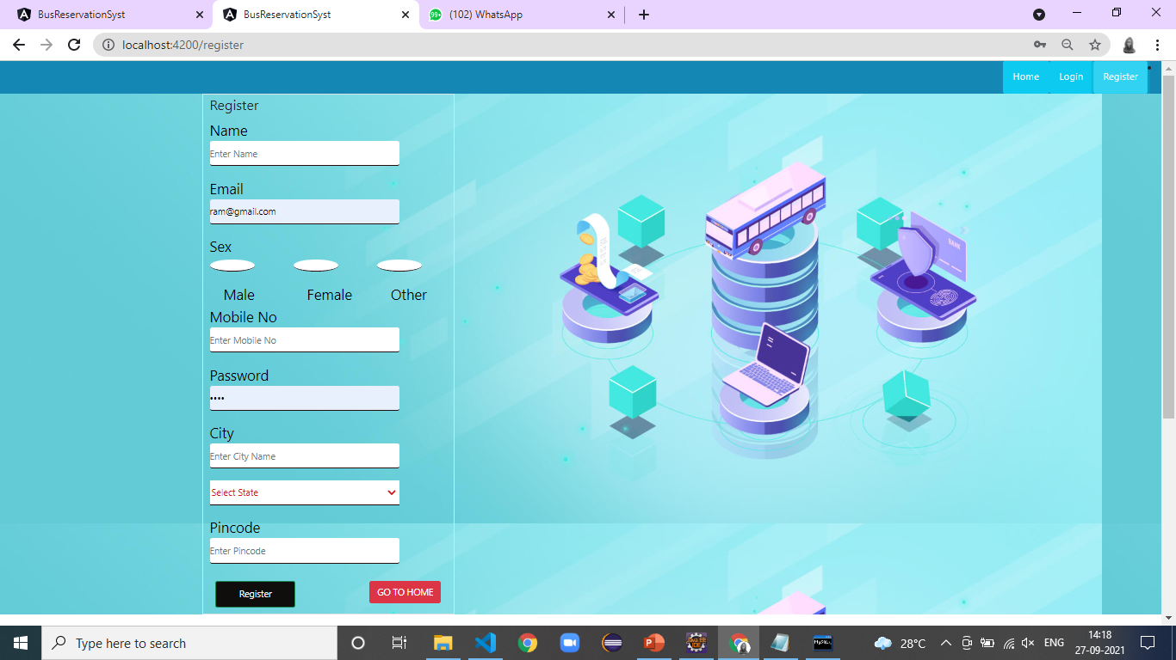

Slide 17
This is Register Page

Slide 18
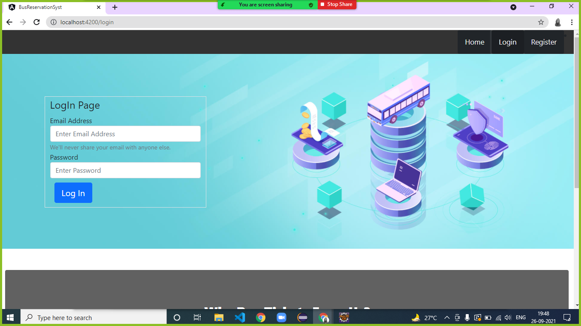

Slide 20
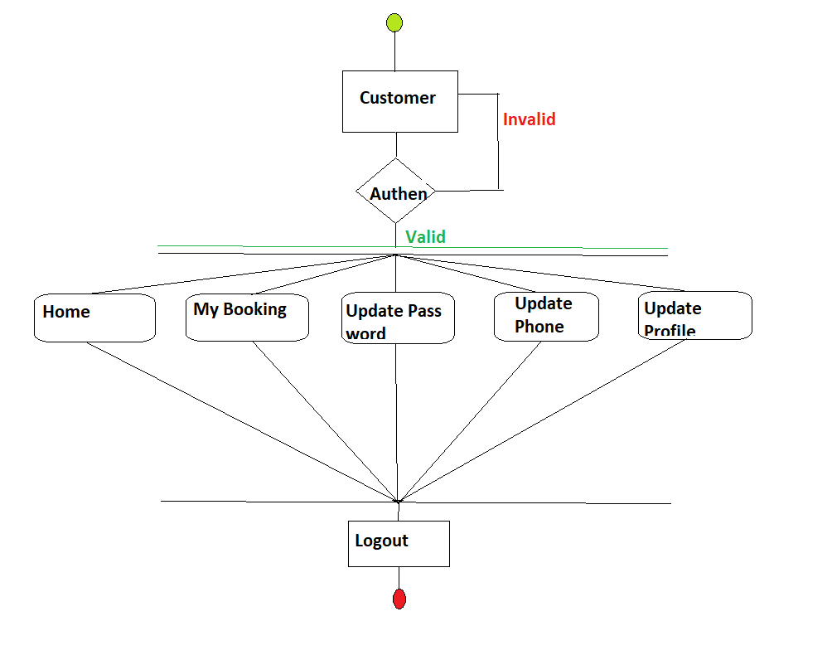
ACTIVITY DIAGRAM FOR CUSTOMER

Slide 21
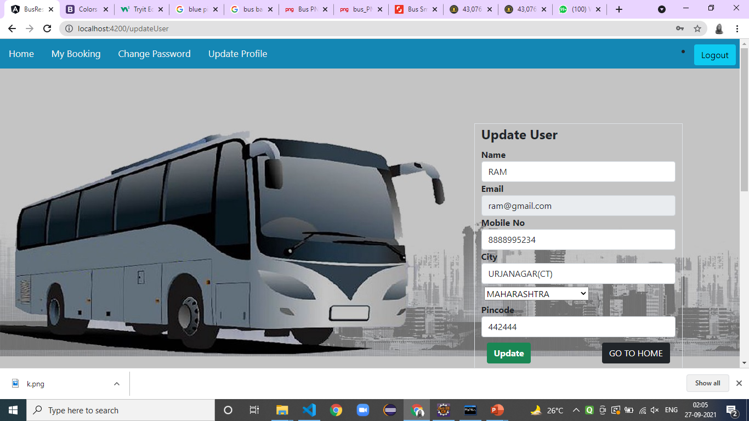

Slide 22
User can check there bookings, update password and update profile.

Slide 23
Update users profile.

Slide 24
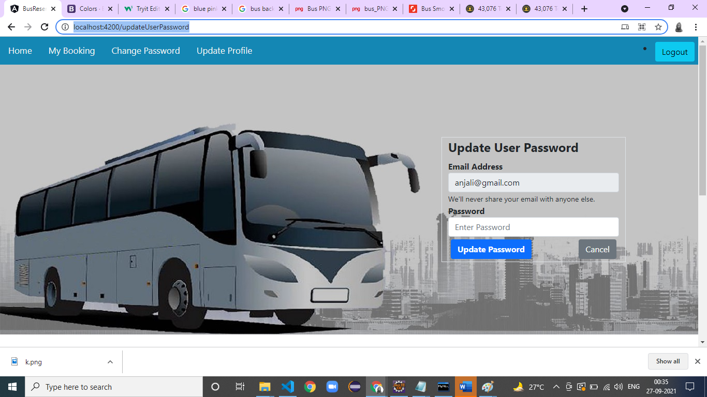
Update users password.

Slide 25
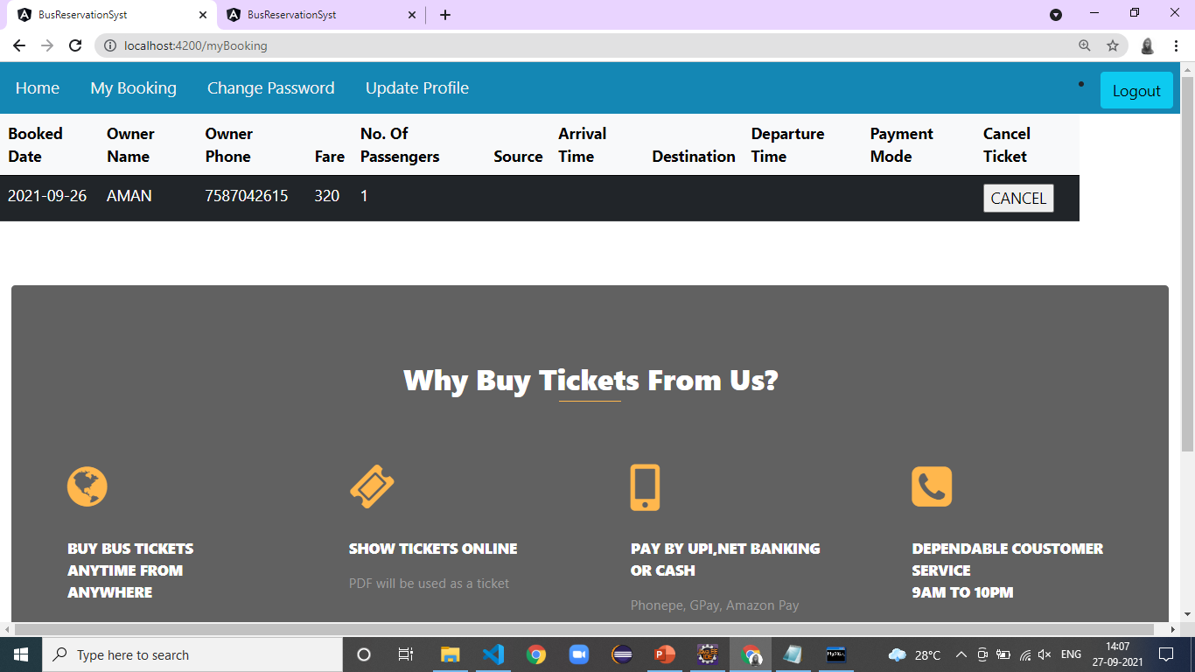
This is my booking page of the Customer.

Slide 26
User can logout from here.

Slide 27
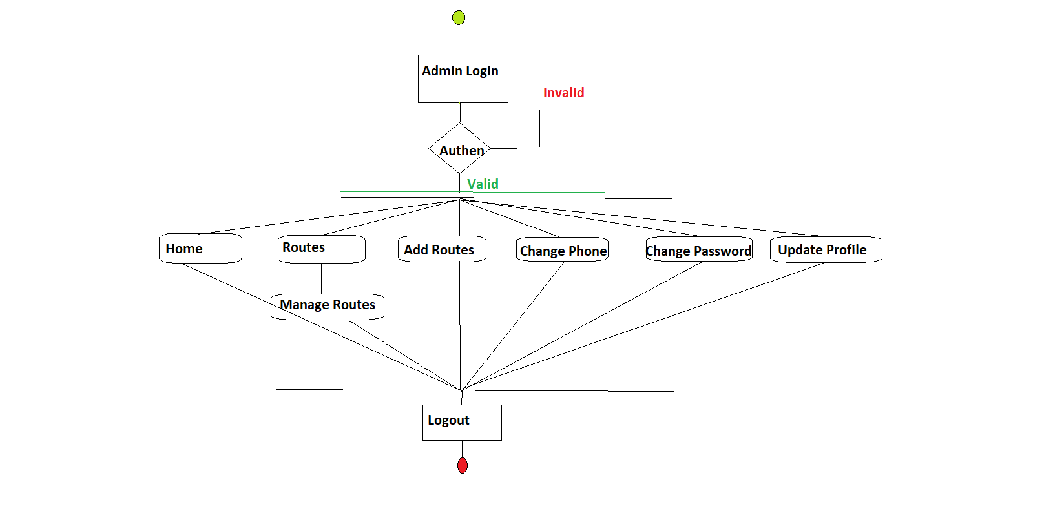

ACTIVITY DIAGRAM OF ADMIN
ADMIN

Slide 28
FEATURES PROVIDED TO ADMIN
ADMIN
Add the route.
Update the bus
Remove the bus
Delete the route
Update the route
Total tickets booked
Add the bus

Slide 29
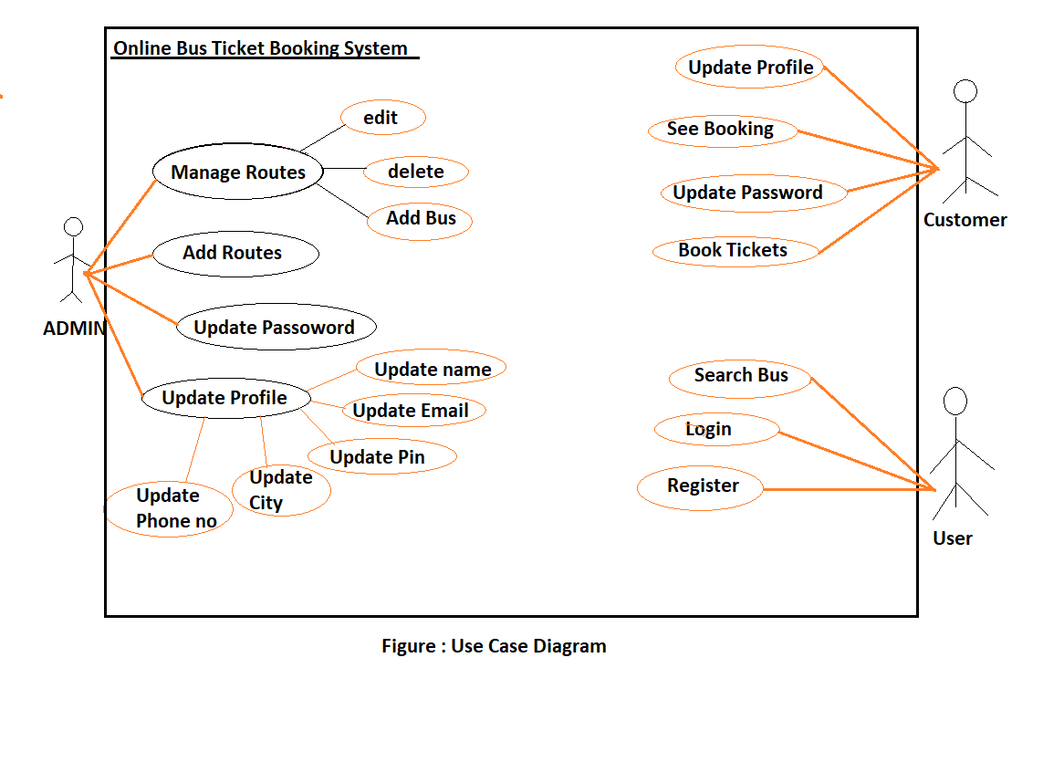
Edit
Delete
Manage Routes
Add Bus
Add Routes
ADMIN
Update Profile
Update Email
Update Password
Update Name
Update Pin
Update Phone no.
Update City

Slide 30
SCREENSHOTS FOR ADMIN PERFORMED OPERATION

Slide 31
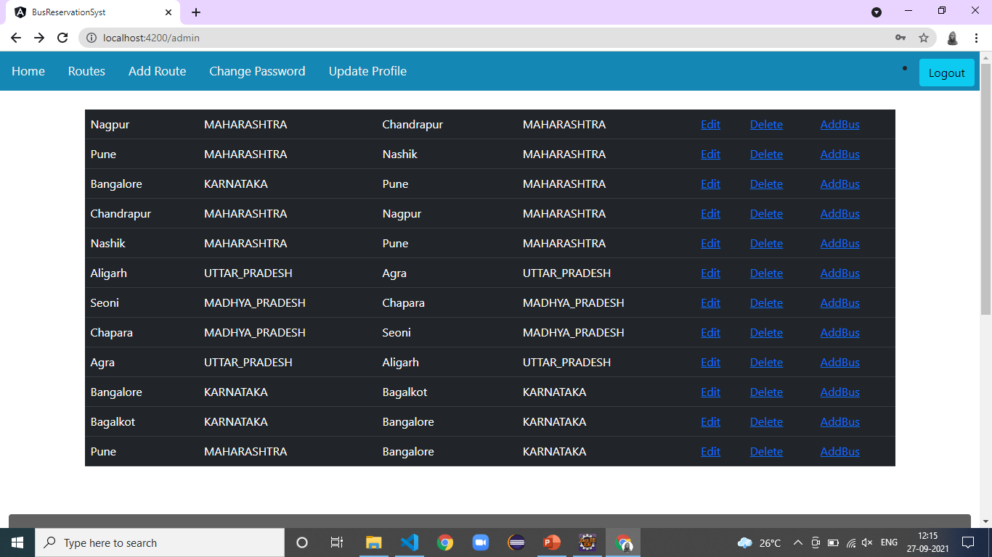

Slide 32
This is the task bar for Admin.

Slide 33
This are Routes

Slide 34
From here, Routes can be edited can be deleted and also buses for the Routes can be added

Slide 35
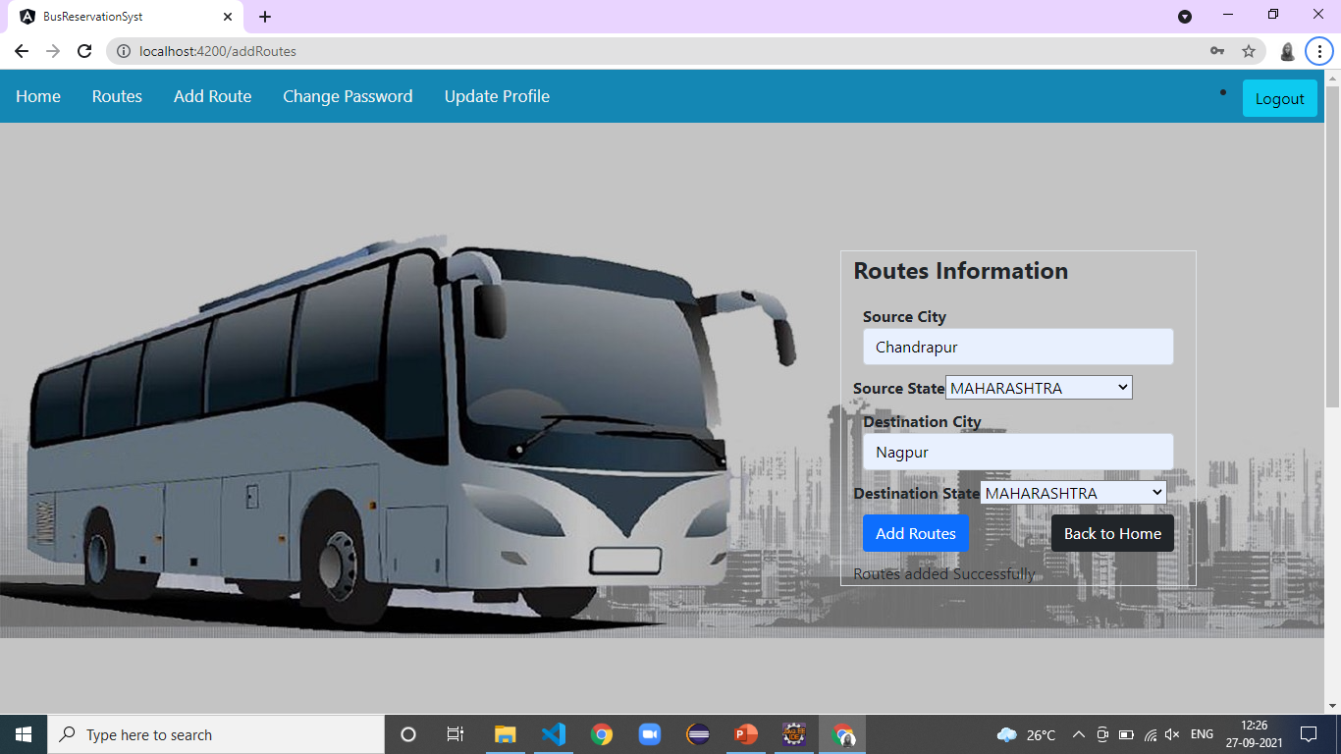
Here Admin can add Routes

Slide 36
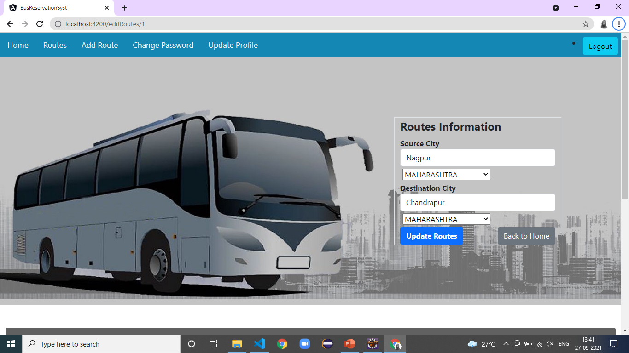
Here Admin can Update Routes

Slide 37
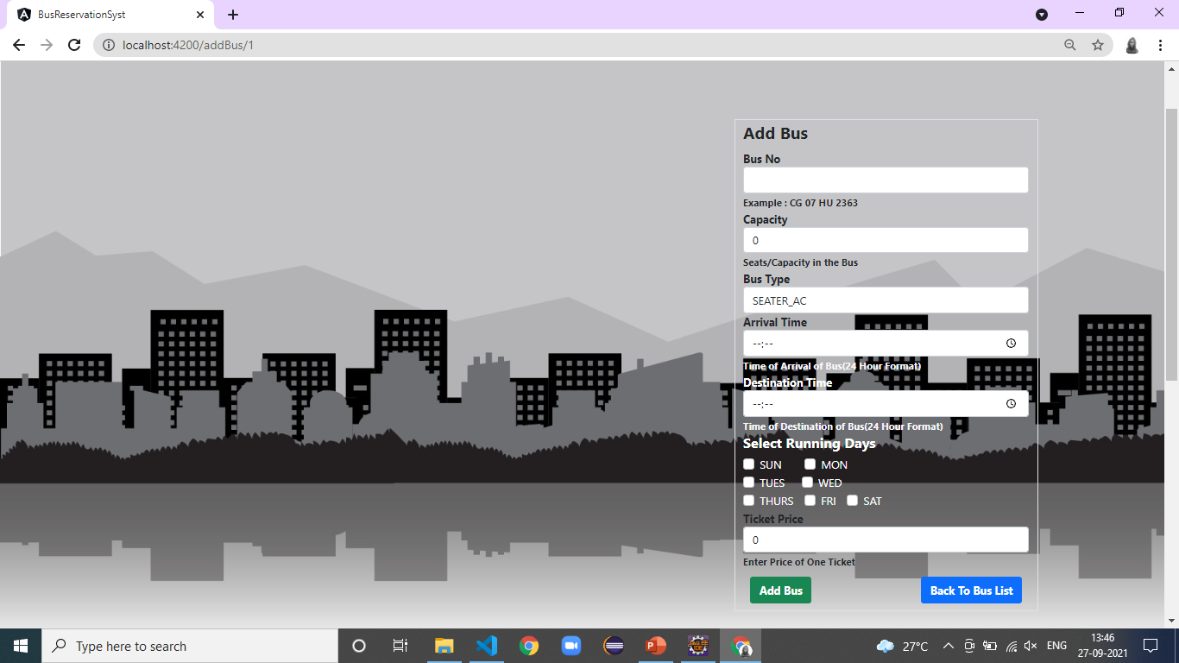

Slide 38
Here Admin can add bus for specific routes

Slide 39
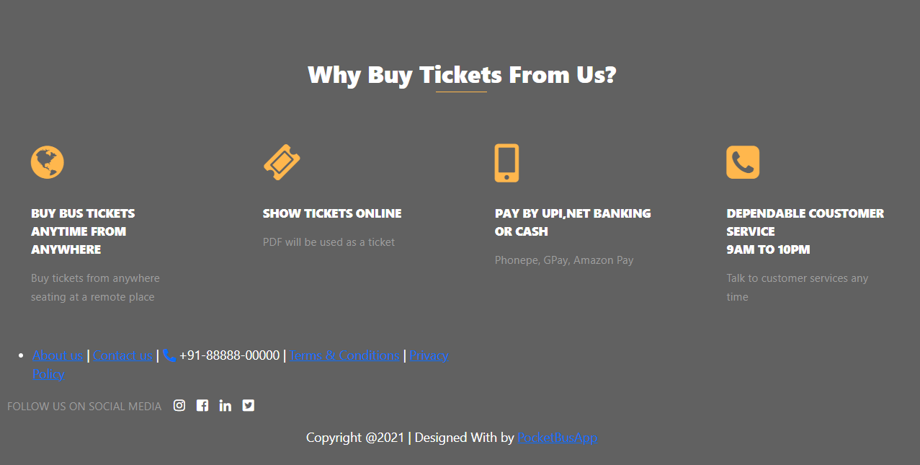
FOOTER SCEENSHOT

Slide 40
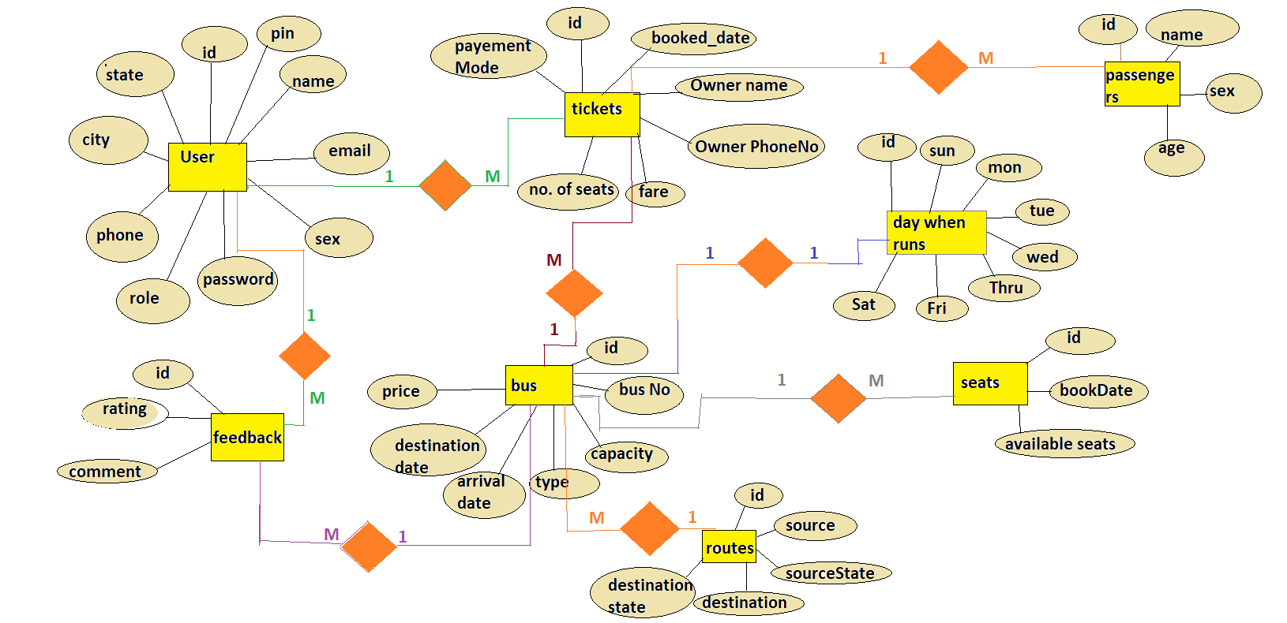
ER DIAGRAM

Slide 41
BENEFITS OF ONLINE TICKET BOOKING SYSTEM
This system will help to maximize the number of Reservations.
Easy to Manage the calender.
Easy to Manage all the records.
This System is fully functional and flexible.
Easy to use.
Saves lot of time,money and Labour.
This Application acts as an office that is open 24/7.

Slide 42
FUTURE SCOPE
This project can be enhanced further by adding the Agent Module to perform the agent related functionalities,The generated ticket can be sent on the email id of the customer.
The website is flexible enough to be modified and implemented as per future requirements.
We have tried our best to present this website.Messages and Email alerts for various things can be sent to the Users so that they cannot miss anything.
The offers information for various festival seasons can be send to the User.The payment related things can be upgraded .

Slide 43
REFERENCES
https://stackoverflow.com
https://www.javatpoint.com
https:docs//oracle.com
Geeksforgeeks
https://angular.io/api

Slide 44


